Slide 1
Universal coverage of essential health services in sub Saharan Africa: projections of domestic resources
Carlos Avila, Catherine Connor,
Tesfaye Dereje, Sharon Nakhimovsky and Wendy Wong
Health Finance and Governance Project
17 July 2013

Slide 2
Outline
Background
Questions addressed
Methods
Results
Limitations
Summary & conclusions
Implications for donors

Slide 3
Background
High level advocacy to mobilize more funding for health dominated the first decade of the new millennium, from
  the Commission on Macroeconomics and Health in 2001 to the
  Taskforce on Innovative International Financing for Health Systems in 2009 and
  the UN Millennium Project (MDGs)
  Abuja commitment (15% of budget on health)
During the same decade, some African countries experienced unprecedented economic growth, and improvements in governance, trade, health status and life expectancy.

Slide 4
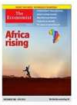

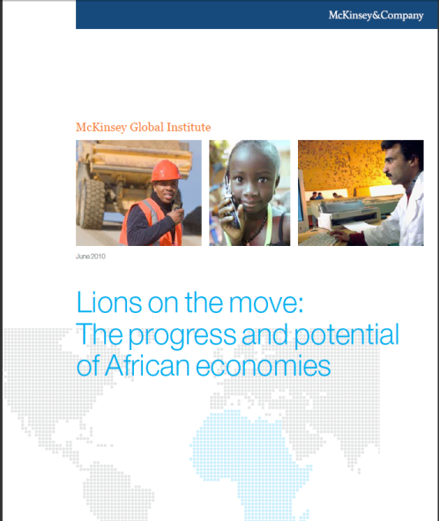

Africa Rising

Slide 5
Questions addressed

Slide 6
Questions addressed
Can the region’s continued economic growth lift African countries’ domestic health spending to the target of $60 per person per year by 2020?
If in addition to economic growth, African governments fulfilled the Abuja commitment, which countries would reach the spending target?
What is the projected impact on household out-of-pocket expenditures on health?
What financing gap would remain in 2020?

Slide 7
methods

Slide 8
Methods 1: Sources and models
Established a baseline level of domestic health spending for 43 sub-Saharan African countries using data from the WHO Global Health Observatory.
Estimated two policy-relevant models to project domestic health spending to 2020:
  (1) domestic health spending increases with economic growth and
  (2) in addition to economic growth, government expenditures allocated to health increase until they reach the Abuja commitment.

Slide 9
Methods 2: The target is a set of cost-effective health services for $60/capita
“…extending the coverage of health services and a small number of critical interventions to the world's poor could save millions of lives, reduce poverty, spur economic development, and promote global security” --Commission on Macroeconomics and Health, 2001
  Taskforce on Innovative International Financing for Health Systems, 2009
  Public investments in health and the MDGs; UN’s Millennium Project, 2010

Slide 10
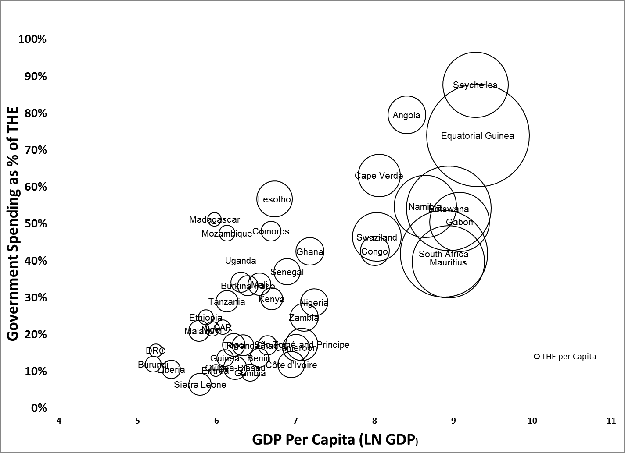
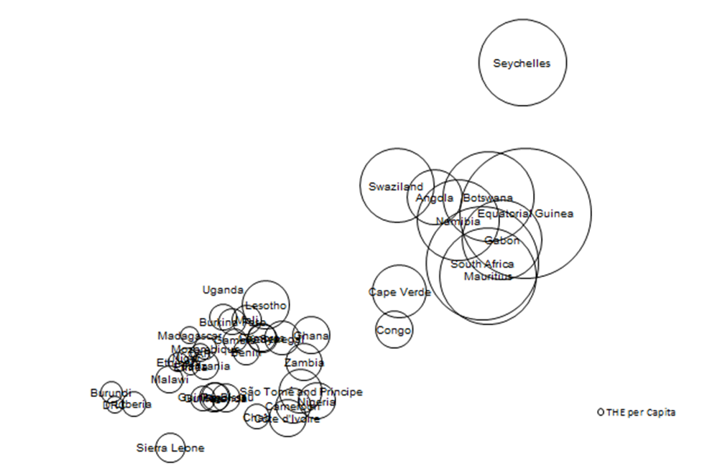
Methods 3: Domestic health spending per capita increases with GDP (Baseline-2010)
$54 $148 $403 $1,097 $2,981 $8,103
GDP Per Capita (Log Scale)

Slide 11
Summary of assumptions used to project total domestic health spending
 | Economic Growth | Economic Growth and Abuja Commitment
Basic assumption | GDP per capita increases each year from 2010-2016 as projected by the IMF. 2017-2020 projections based on average growth during the prior five years.
Government | GGHE spending projected growth rate in relation to a 1% growth in GDP per capita:^{[1]} 1.305% for low income countries 0.557% for lower-middle income 0.661% for upper-middle income 0.702% for high income | Same as Assumption 1, plus GGHE, as a percentage of total government expenditures, increases by one percentage point per year until 15% of total government expenditures is reached.
Private non-household (employers, insurance) | Private non-household spending projected growth rate in relation to a 1% growth in GDP per capita:^{[2]} 1.26% for low income countries 0.95% for middle income 0.66% for high income | Same as Assumption 1
Private out-of-pocket household expenditures (OOP) | OOP spending projected growth rate in relation a 1% growth in GDP per capita:^{[1]} 1.098% for low income countries 0.869% for lower-middle income 0.842% for upper-middle income 1.503% for high income | Same as Assumption 1
^{[1]} (Xu, Saksena, & Holly, 2011)
^{[2]} (Govindaraj, Chellaraj, & Murray, 1997)
Notes:
Ke Xu, Priyanka Saksena, Alberto Holly. The determinants of health expenditure: A country-level panel data analysis. WHO publications on Health Financing. Available at: http://www.who.int/health_financing/documents/cov-report_e_11-deter-he/en/
Govindaraj R, Chellaraj G, Murray CJL. Health expenditures in Latin America and the Caribbean. Social Science & Medicine 1997;44:157-69.

Slide 12
Results

Slide 13
Observed health spending by source in 41 SSA countries, 2000-2010
 | 2000 |  | 2010 |  | 2000-10
Source of heath expenditure | USD per capita | As % of THE | USD per capita | As % of THE | % Change of USD
Total health expenditure (THE) | $16 | 100% | $88 | 100% | 452%
Government | $6 | 37% | $32 | 37% | 433%
Household out-of-pocket (OOP) | $5 | 30% | $24 | 28% | 385%
Private non-household | $4 | 28% | $21 | 23% | 379%
External | $1 | 5% | $11 | 12% | 1275%

Slide 14
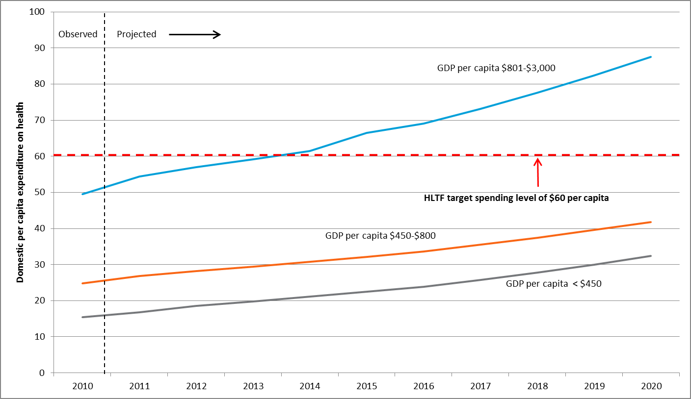
Growth in total domestic health spending assuming economic growth: country averages for the lower three quartiles of GDP per capita

Slide 15
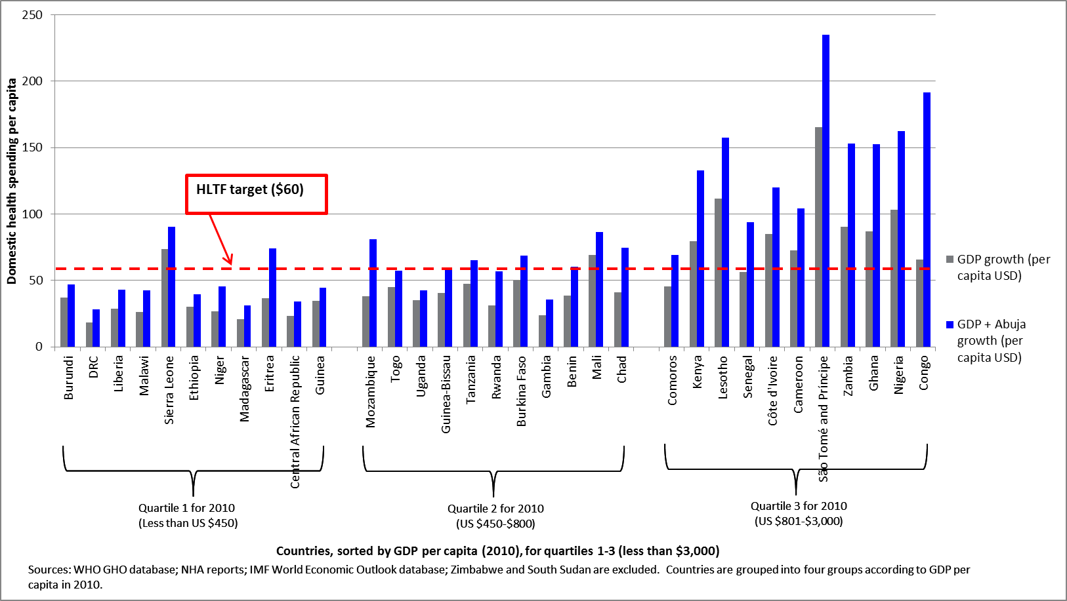
Per capita domestic health spending in 2020 under economic growth only and economic growth with the Abuja commitment

Slide 16
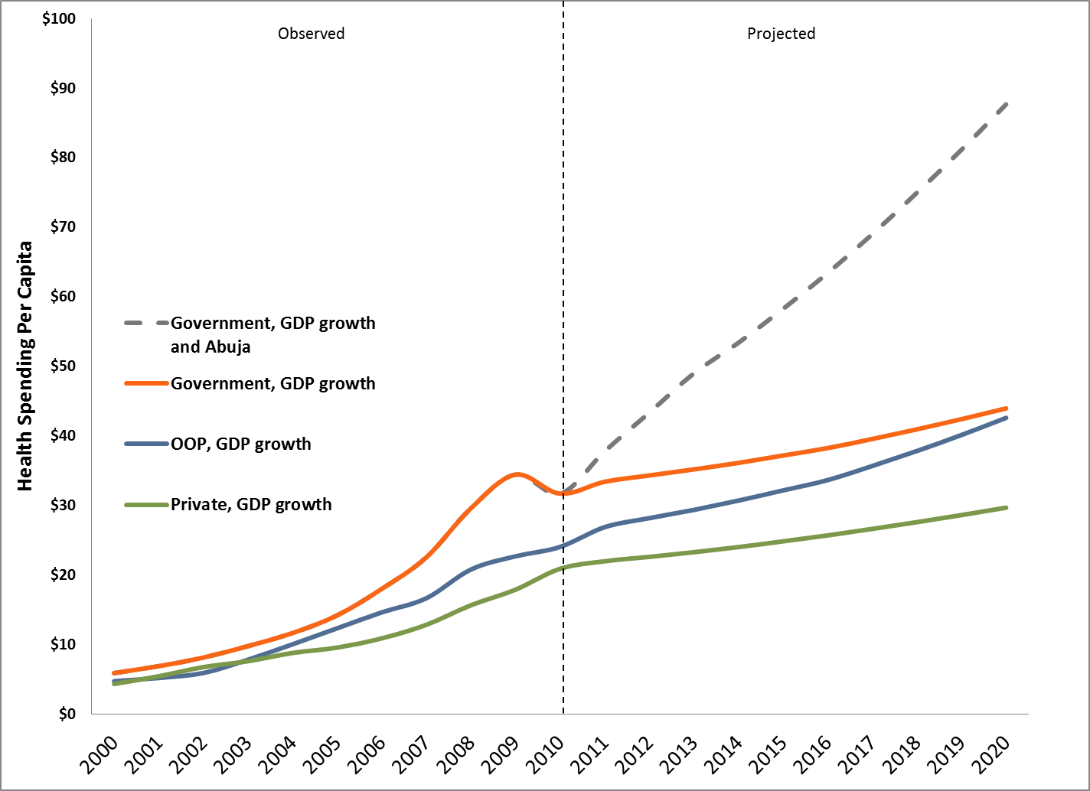
Growth in domestic health spending in 43 countries, under economic growth and Abuja commitment, by source, 2000-2020
Political commitment

Slide 17
Countries reaching the $60 per capita spending target through health financing from domestic sources
Year | Economic Growth |  | Economic Growth + Abuja commitment
 | Countries | Count | Countries | Count
2010 | Angola, Botswana, Cape Verde, Equatorial Guinea, Gabon, Lesotho, Mauritius, Namibia, São Tomé and Príncipe, Seychelles, South Africa, Swaziland | 12 | Angola, Botswana, Cape Verde, Equatorial Guinea, Gabon, Lesotho, Mauritius, Namibia, São Tomé and Príncipe, Seychelles, South Africa, Swaziland | 12
2011 | Congo, Côte d'Ivoire, Nigeria | 15 | Congo, Côte d'Ivoire, Nigeria | 15
2012 |  |  | Cameroon, Ghana, Zambia, | 18
2013
2014 | Cameroon, Ghana, Zambia | 18
2015 |  |  | Kenya, Mali, Senegal | 21
2016 |  |  | Sierra Leone | 22
2017
2018 | Kenya, Mali, Sierra Leone | 21 | Burkina Faso, Chad, Comoros, | 25
2019 |  |  | Eritrea, Mozambique, Tanzania | 28
2020 |  |  | Benín | 29

Slide 18
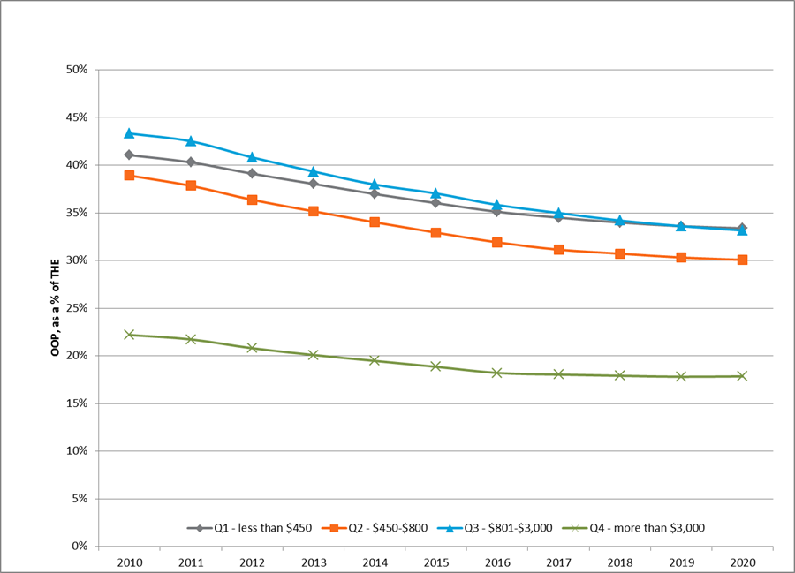
OOP spending as a percent of THE by country income quartile assuming economic growth and Abuja commitment is met

Slide 19
Funding gap in 2020
To reach the $60 per capita target with economic growth alone, 21 countries would face a collective funding gap of $14.5 billion in 2020.
7 countries account for 78% of the gap
DRC, Ethiopia, Uganda and Madagascar will have the highest projected gaps in 2020
The collective funding gap would drop to $8.2 billion in 2020, IF countries met the Abuja commitment.

Slide 20
Funding gap under the two projections for total domestic health financing growth by 2020 (million US$)
 | Economic growth | Economic growth plus Abuja
Democratic Republic of the Congo | 3,948.66 | 2,995.03
 | 3,173.63 | 2,196.60
Ethiopia | 1,196.98 | 845.40
Uganda | 1,061.57 | 782.33
Madagascar | 695.92 | 360.00
Malawi | 658.08 | 287.76
Niger | 638.05 | -
United Republic of Tanzania | 571.58 | -
Mozambique | 357.08 | 36.70
Rwanda | 337.87 | 204.00
Guinea | 274.83 | -
Benin | 249.85 | -
Chad | 229.25 | 131.29
Burundi | 216.75 | 154.04
Central African Republic | 186.76 | -
Burkina Faso | 184.48 | 98.45
Liberia | 166.51 | -
Eritrea | 135.63 | 23.95
Togo | 87.51 | 59.15
Gambia | 61.45 | -
Senegal | 40.56 | 0.91
Guinea-Bissau | 11.85 | -
Total Funding Gap | 14,484.84 | 8,175.62

Slide 21
Limitations & Caveats

Slide 22
Limitations 1
Health spending on average has tended to increase with economic growth; however, individual country income elasticity varies.
The WHO Global Health Observatory data on government health expenditures includes on-budget donor funding.
We used detailed NHA data from a 10 countries to adjust the estimates of government health expenditure and non-OOP private spending to remove donor funding.
Limitations of the HLTF analysis to estimate the cost of a package of essential services are presented in their publications.

Slide 23
Limitations 2
The assumption that governments will choose to fulfill the Abuja commitment is very optimistic given that very few countries have met the Abuja commitment since it was declared in 2001.
THE per capita masks significant inequities in almost all the countries.

Slide 24
Caveats
The assumption that governments spending $60 per capita on health will ensure universal access to essential services is far from assured
Country | Total health expenditures per capita (Constant 2010 USD) | % of women of reproductive age with unmet need for family planning | Year of DHS and expenditure data
Congo (Brazzaville) | $51.69 | 19.5 | 2005
Gabon | $121.34 | 27.9 | 2000
Lesotho | $77.88 | 23.3 | 2009
Namibia | $355.30 | 20.7 | 2006-07
São Tomé and Príncipe | $106.31 | 37.6 | 2008-09
Swaziland | $197.76 | 24.7 | 2006-07

Slide 25
Summary, conclusions, AND IMPLICATIONS FOR DONORS

Slide 26
Summary
Summary
Current spending (2010) | Projections based on economic growth (2020) | Projections based on economic growth and Abuja commitment (2020)
12 countries already meet the HLTF target of spending at least $60 per capita on health from domestic sources | 9 additional countries meet the target for a total of 21 22 countries need additional support to close an estimated funding gap of $14.5 billion. | 17 additional countries meet the target for a total of 29 14 countries need additional support, $8.2 billion funding gap.
THE US$ 69 billion | THE US$ 130 billion | THE US$ 174 billion
Public sources $25 billion (36%) Private sources $16 billion (23%) Households $19 billion (28%) | Public sources $44 billion (34%) Private sources $30 billion (23%) Households $43 billion (33%) | Public sources $92 billion (53%) Private sources $30 billion (17%) Households $43 billion (25%)

Slide 27
Conclusions
Rising domestic resources alone are not enough to ensure access to essential health services in all countries.
Leadership and other governance actions are required.
Countries and their partners need to emphasize key health financing priorities in addition to resource mobilization:
  efficient allocation to essential health services and to underserved populations;
  improved risk pooling and
  strategic purchasing for quality and efficiency.

Slide 28
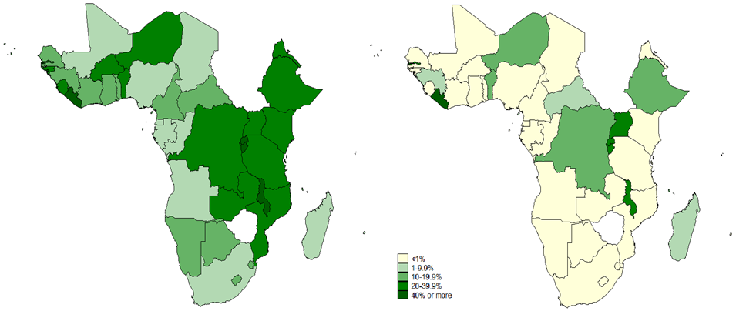
Implications for donors
High dependency
Low dependency
Expected changes in external assistance as percentage of THE,
under economic growth and Abuja commitment, 2010 and 2020

Slide 29
Implications for donors
How to encourage countries to meet the Abuja commitment?
How to enable countries to make the most of their expanding funding envelope?
  To allocate funds to essential health services
  To target underserved populations
  To expand risk pooling (rich subsidize the poor; healthy subsidize the sick)
  To use purchasing power to improve quality and efficiency

Slide 30
Thank you
www.hfgproject.org

Slide 31
Measuring the rise in domestic health spending as GDP increases
Income elasticity of demand measures the relationship between a change in the quantity of a good demanded versus the change in the income of the people demanding the good.
A large body of evidence shows a strong and positive correlation between national income (GDP) and domestic expenditure on health care
Overall, as GDP increases the share of government spending on health increases
It is calculated as the ratio of the percentage change in demand to the percentage change in income. For example:
  if, in response to a 10% increase in income, the demand for health services increased by 13%, the income elasticity of demand would be 13%/10% = 1.3
  if, in response to a 10% increase in income, the demand for health services increased by 6.5%, the income elasticity of demand would be 6.5%/10% = 0.65

