Slide 1
Provisions of the National Health Act The Basic Healthcare Provision Fund

Slide 2
Content
Background
Rationale for operations manual
Operationalizing the BHCPF
Journey so far

Slide 3
Content
Background
Rationale for operations manual
Operationalizing the BHCPF
Journey so far

Slide 4
The National Health Act, was signed into law in 2014, to provide a Framework of Action…
For the regulation, development & management of a National Health System and sets standards for rendering health services in the federation;
Assure quality care through regulation of Health establishments and technologies whilst ensuring the rights of users.
Strategic financing from “bottom-of-the pyramid” of healthcare operations through the Basic Healthcare Provision Fund that will pool at least 1% of Consolidated Revenue Fund with other resources

Slide 5
…with the Act earmarking funds to guarantee an explicit package of high impact interventions
The Basic Health Care Provision Fund (BHCPF or “The Fund”) is established under Section 11 of the National Health Act (NHA Act), as the principal funding vehicle for the Basic Minimum Package of Health Services (BMPHS)
Funds from any other source
The Fund serves to increase the fiscal space and overall financing to the health sector to assist Nigeria achieve Universal Health Coverage (UHC).
Grants by International Donor Partners
Funding of the BHCPF would be derived from contributions including
an annual grant from the Federal Government of Nigeria of not less than one per cent (1%) of its Consolidated Revenue Fund (CRF)
grants by international donor partners;
funds from any other source
Not less than 1%
Consolidated Revenue Fund

Slide 6
Stipulation of the Act
Money from the Fund shall be used to finance the following:
50% of the Fund shall be used for the provision of basic minimum package of health services to citizens, in eligible 'primary or secondary health care facilities through the National Health Insurance Scheme (NHIS);
"basic minimum package" means the set of health services as may be prescribed from time to time by the Minister after consultation with the National Council on Health;
20 per cent of the Fund shall be used to provide essential drugs, vaccines and consumables for eligible primary health care facilities;
( c) 15 per cent of the Fund shall be used for the provision and maintenance of facilities, equipment and transport for eligible primary healthcare facilities; and
(d) 10 per cent of the Fund shall be used for the development of human resources for primary health care;
(e) 5 per cent of the fund shall be used for emergency medical treatment to be administered by a Committee appointed by the National Council on Health.

Slide 7
The Basic Health Care Fund is premised on four key levers
Dedicated
Funding
Mechanism
Additional fiscal space
1% of the Consolidated Revenue Fund (CRF) is statutorily allocated to health
Funding is expected to be channeled towards delivery of primary care services
Demand and
Supply side
financing
Strategic purchasing of a minimum package of health services
Investments in the building blocks of the health system in a manner that improves the quality of care
Strong
Coordination
Federal, States and LGAs all have a role to play
Organized delivery of health care services
Clearly established lines of accountability
Funds to address critical needs
Robust data and performance frameworks for continuous evaluation
Robust
governance and
Accountability
framework

Slide 8
In operationalising the BHCPF, four priority areas are being considered
Gateway
Operations
What have we learnt from previous experiences
What should we be doing differently
What objectives do we aim to achieve
How do we ensure complementarity rather than substitution
What should the basic package comprise
Governance and
Administration
Given that the Act stipulates multiple sources of funding: (i) what should the governance look like? (ii) how do we strengthen accountability and transparency in a manner that gives comfort to donors but also does not create multiple layers of bureaucracy thus rendering the program implementable?
How do the different players work in a concerted manner
Financial
Management
& disbursement
How should the funds flow
What measures do we put in place to guarantee fund sustainability
Monitoring and
Evaluation
What do we want to measure?
What are the sources to be used? Surveys, administrative data etc
How do we want to measure?
Use of data

Slide 9
A phased roll out of the BHCPF in anticipation of government funding
1
With delays in realizing the government contributions, donor partners put resources forward
2
The Federal Ministry of Health, her agencies
and partners began working towards implementation of the BHCPF starting with 3 States
3
These States (Abia, Niger, and Osun States)
were chosen following a readiness assessment
exercise. Furthermore, the State governments
have demonstrated commitment with
contributions of N100M each.
4
When implemented the BHCPF will be the largest social
program of the Federal Government with the
potential of reaching 8 million rural Nigerians with
quality, high impact and live saving health interventions
rendered at no direct cost to

Slide 10
Nigeria has experienced decades of limited progress on service delivery
Sources: NDHS 1990, 1999, 2003, 2008, 2013 & MICS 2016-17

Slide 11
With sub-national analysis providing a truer reflection of the challenges – Geopolitical
Antenatal Care Coverage by Geopolitical Zone

Slide 12
Antenatal Care Coverage by Urban and Rural Areas 2003-13
With sub-national analysis providing a truer reflection of the challenges – Urban vs Rural
Source: NDHS 2003, 2008, 2013

Slide 13
Coverage of Key Health Interventions by Income Quintile
With sub-national analysis providing a truer reflection of the challenges – Wealth Quintiles

Slide 14
The poor are particularly worse off, with the poorest 40% of population 2.6 times more likely to die Under 5
Under 5 mortality rates by Income Quintile

Slide 15
Content
Background
Designing the operations for the BHCPF
Operationalizing the BHCPF
Program cost and sustainability

Slide 16
On gateway operations - We recognized the structural and operational challenges within the health system hence the Operations Manual
Policy
Service Delivery
Financing
Objectives
Primary Health Care delivery is a State level function and has been clearly articulated in several policy documents such as the PHCUOR
Although Federal has always been involved, it served to ensure equality in access to public goods such as immunization
Service delivery has failed in the past, due to issues such as (i) poor delineation of roles leading to a lack of accountability (ii) focus on input financing with limited considerations on outcomes.
Caseload of 1.5/day and low productivity reflect poor management and allocation of resources, barriers to access of patient preferences.
At about N250 per capita, there are significant limitations on what the funds can realistically buy.
Focus on high impact and measurable interventions
Ensure BHCPF is complementary
Recognize role of States in PHC delivery and use BHCPF as lever for accountability
Maintain fiduciary discipline to enable program unlock additional resources
Increase utilization and health outcome

Slide 17
Service delivery fails due to lack of incremental funds to support critical interventions community outreaches, basic repairs, data collection and transmission
Proportion of facilities receiving cash funding, by source
Facilities charge user fees to compensate for lack of steady operational expenses
Arbitrary charges serves a s a disincentive for patients and they tend to forgo care.
Lack of transparency around fund use means State is unable to plan and maximize resources

Slide 18
Background
Rationale for operations manual
Operationalizing the BHCPF
Journey so far

Slide 19
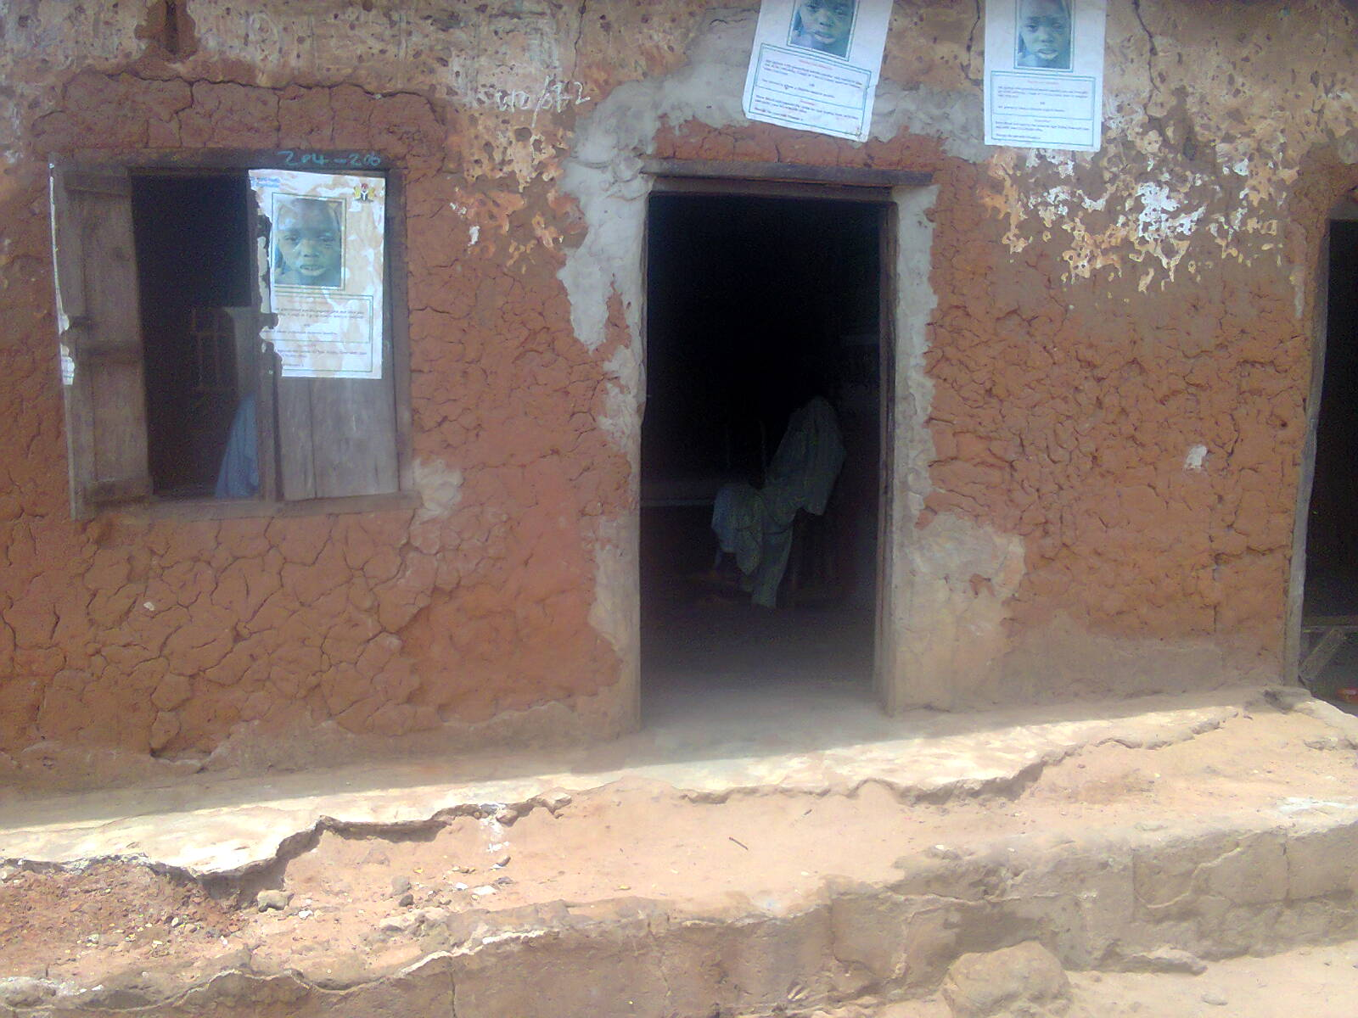
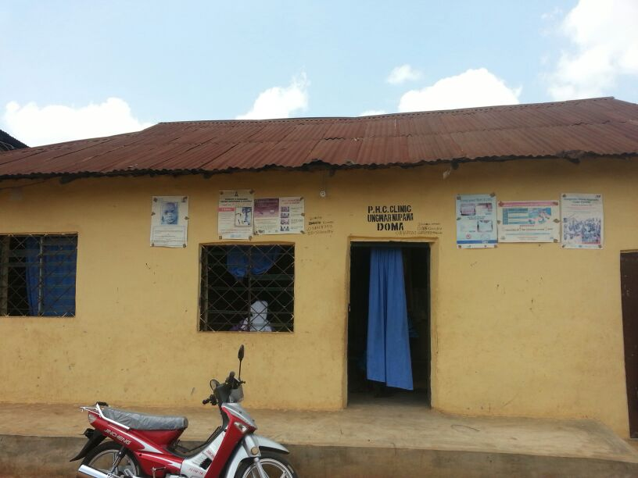
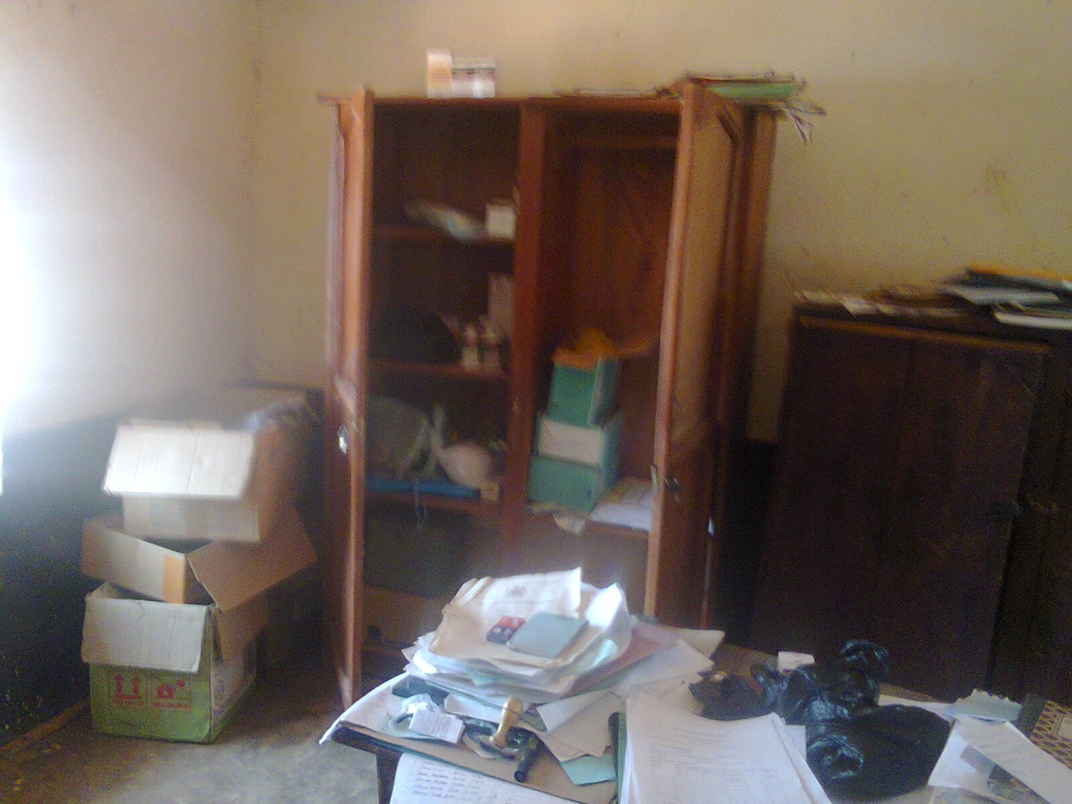
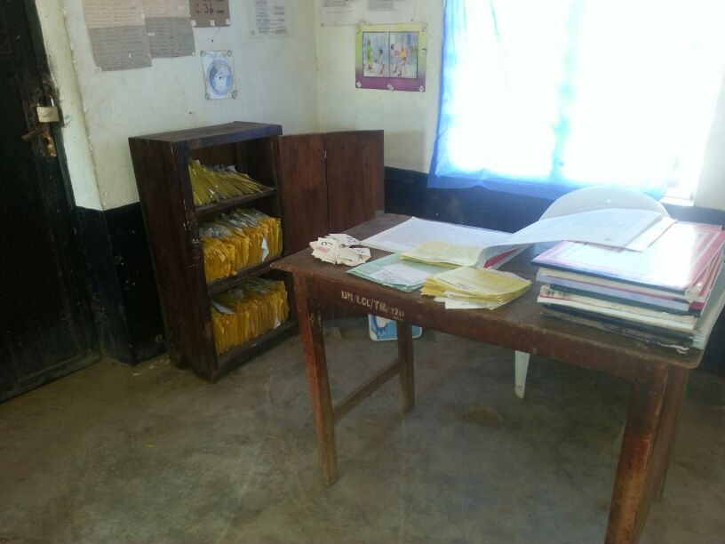
Contents of the Operations Manual: Resources under the NPHCDA gateway will fund operational expenses at the frontline
May 2015
May 2014
May 2015
FUND FLOW AND USE
PHC Arumangye
Drug store
Funds will flow from the NPHCDA, through the SPHCDAs, directly to the facilities.
Facilities will use funds to improve quality of service delivery based on a quality improvement plan with quantifiable outcome measures
A scoring system will be used to determine facility improvements towards a stepwise accreditation plan
PHC Ungwan Nupawa front view store
PHC Doma Town, Record section

Slide 20
BMPHS defined: resources under the NHIS gateway will guarantee an explicit package of services – PREGNANT WOMEN
ANTENATAL CARE
Blood test / haemoglobin screening / urinalysis
Syphilis detection and treatment
Hepatitis B screening
Deworming
PMTCT (HIV testing, counselling, ART for positive newborn)
ANC visits (4 visits)
Tetanus toxoid (2 injections)
Management of hypertension without proteinuria
Anemia treatment
Intermittent presumptive treatment of malaria (IPT)
Case management of malaria
Daily iron and folic acid supplementation in pregnant women
Management of pre-eclampsia
Antenatal Corticosteroid
Antibiotics for pPRom
DELIVERY
Labor and Delivery Management
Active management of third stage of labour (AMTSL)
Induction of Labor (beyond 41 weeks)
Obstructed Labor - Ceasarian Section
Management of eclampsia
POSTNATAL CARE
Newborn resuscitation
Newborn – Treatment of local infections
Kangaroo Mother Care
Postnatal preventive care
Mastitis
Newborn Sepsis - Injectable Antibiotics
Postpartum Hemorrhage
Maternal sepsis management
Newborn Sepsis - Full Supportive Care
Payments for care rendered will be case based.
This guarantees that (i) services have been rendered (ii) scarce resources are maximized (iii) patient receive care for free thus increasing utilization

Slide 21
Guided by the program objectives, resources under the NHIS gateway will guarantee an explicit package of services – CHILDREN
UNDER 5 ILLNESSES
Vitamin A supplementation for treatment of xerophthalmia
ORS and zinc for diarrhea treatment
Antibiotics for dysentery
Pneumonia treatment (ren)
Malaria Treatment (ren)
Vitamin A for measles treatment (ren)
Multiple micronutrient powders
Treatment of severe diarrhea (ren)
Treatment of severe malaria (ren)
Treatment of severe pneumonia (ren)
Treatment of severe measles
Treatment of severe acute malnutrition
Vaccination_Pneumococcal (3 doses)
Vaccination_Polio (3 doses)
Vaccination_BCG (1 dose)
Vaccination_Pentavalent (3 doses)
Vitamin A supplementation
Vaccination_Measles (2 doses)
Vaccination_Yellow_Feaver
Payments for care rendered will be case based.
This guarantees that (i) services have been rendered (ii) scarce resources are maximized (iii) patient receive care for free thus increasing utilization

Slide 22
Guided by the program objectives, resources under the NHIS gateway will guarantee an explicit package of services – ADULTS
FAMILY PLANNING
Pills
Condom
Injectable
IUD
Implant
ADULTS
Screen for risk of cardiovascular disease and diabetes
ALL
Malaria treatment (population over 5)
Payments for care rendered will be case based.
This guarantees that (i) services have been rendered (ii) scarce resources are maximized (iii) patient receive care for free thus increasing utilization
Plus Treatment of Moderate Malnutrition

Slide 23
On identification, each beneficiary will receive an identity card

Slide 24
Content
Background
Rationale for operations manual
Operationalizing the BHCPF
Journey so far

Slide 25
In the last 1 year we have received commitment from partners. We are developing the operations manual and supporting the States in preparation for implementation
1.
Partner support through GFF and BMGF
2.
Federal support for the State process
With donor funds expected, the
Financial guidelines
Procurement rules
Environmental and social
Impact safeguards are subject to agreements signed between FG & World Bank
Conditions precedent include:
(i) Accounts to be opened at the CBN for all the implementing entities and facility level accounts opened at commercial banks
(ii) Robust Performance metrics with M&E
(iii) External verification of results
Opening of facility accounts
Capacity building for SPHCDA & SSHIA ongoing
Engaging stakeholders on different aspects of the program
Baseline assessments

Slide 26
In the last 1 year we have received commitment from partners. We are developing the operations manual and supporting the States in preparation for implementation
Activities
Progress
Baseline survey of facilities
Capacity building for SPHCDA & SSHIA
Facility level accounts
MOUs /agreements
Environmental safeguards
FGN appropriation of 1% CRF
GFF Grant

Slide 27
A lot of work still needs to be done with the Federal Stakeholders and the states
FMOH and Agencies still need to agree on sections in the Operations Manual
1.
2.
Federal support for the State process
Functions of the Secretariat to the National Steering Committee
Funding Flow Mechanism
Opening of all the CBN Accounts
Opening of facility accounts
Capacity building for SPHCDA & SSHIA ongoing
Engaging stakeholders on different aspects of the program
Baseline assessments
For other Stakeholders
3.
Continuous Awareness Creation, Advocacy and Engagement with all stakeholders to have a shared vision.

Slide 28
Thank you!

